Slide 1
Discrete Mathematics
South China University of Technology

Slide 2
Chapter 2. Logic and Proof, Sets, and Function
Functions
Section 2.3

Slide 3
Contents
1
Introduction
2
One to One Function and Onto Function
3
Inverse Functions and Composition of Functions
4
Graph and Some Case of Important Function

Slide 4
Introduction

Slide 5
Functions
f(x)=x²
^{h(name)=position}
^{g(name)=sex}

Slide 6
Function: Formal Definition
A function f :A→B is an assignment of exactly one element f(x)∈B to each element x∈A.
f(a)=b
Functions of n arguments: f: A₁ x A₂... x A_{n} → B.
f(a₁ x a₂... x a_{n} )=b
generalizations. A partial (non-total) function f assigns zero or one elements of B to each element x∈A.

Slide 7
Some Function Terminology
If f:A→B, and f(a)=b (where a∈A & b∈B), then we say:
A is the domain of f.
B is the codomain 伴域 of f.
b is the image of a under f.
a is a pre-image of b under f.
In general, b may have more than 1 pre-image.
We also say the signature of f is A→B.

Slide 8
Range versus Codomain
The range is R={b | ∃a f(a)=b }.
Therefore, range ⊆ codomain, i.e., R⊆B
The range is the smallest set that could be used as its codomain.

Slide 9
Range vs. Codomain - Example
Suppose I declare to you that: “f is a function mapping students in this class to the set of grades {A,B,C,D,E}.”
At this point, you know f’s codomain is: __________, and its range is ________.
Suppose the grades turn out all As and Bs.
Then the range of f is _________, but its codomain is __________________.
{A,B,C,D,E}
unknown
{A,B}
still {A,B,C,D,E}

Slide 10
Images of Sets under Functions
Given f:A→B, and S⊆A,
The image of S under f is
f(S) :≡ {f(s) | s∈S} :≡ {b | ∃s∈S: f(s)=b}.
range of f is f(A)

Slide 11
Function vs Relation
We can represent a function f:A→B as a set of ordered pairs
f ={(a,f(a)) | a∈A}.
This makes f a relation between A and B:
f ⊆ A x B
But functions are special:
for every a∈A, there is at least one pair (a,b). Formally: ∀a∈A∃b∈B((a,b)∈f)

Slide 12
Function vs Relation
For every a∈A, there is at most one pair (a,b). Formally:

Slide 13
Functions can be represented graphically in several ways:
f
A
B
•
•
f
•
•
•
•
•
y
a
b
•
•
•
•
x
A
B
Bipartite Graph
Plot
Like Venn diagrams
Notes:
Note that the inverses of the functions in the two diagrams on the left are not functions.
Note also that the plot has gaps if the domain of the function is not the set R

Slide 14
Propositions are functions
A proposition might be viewed as a function from “situations” to truth values {T,F}
p=“It is raining.”
s=our situation here,now
p(s)∈{T,F}.

Slide 15
operators are functions
A propositional operator can be viewed as a function from ordered pairs of truth values to truth values: e.g., ∨((F,T)) = T.
Another example: →((T,F)) = F.

Slide 16
Predicates are functions
A predicate can be viewed as a function from objects to propositions: P :≡ “is 7 feet tall”; P(Mike) = “Mike is 7 feet tall.”

Slide 17
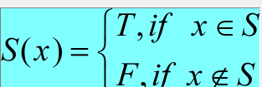
Sets are functions
A set S ⊆ U can be viewed as a function.
Suppose U={0,1,2,3,4}, S={1,3}. Then
S: U → {T, F}.
S(0)=S(2)=S(4)=F,
S(1)=S(3)=T.

Slide 18
Still More Functions
A set operator such as ∩ or ∪ can be viewed as a function … … from ordered pairs of sets, to sets.
Example: ∩({1,3},{3,4}) = {3}

Slide 19
(n-ary) functions on a set
An n-ary function (also: n-ary operator) over (also: on) S is of the form:
f: S^{n} → S, S^{n}=SxS ... x S
Example 1. ¬, ∧,∨ are 1-ary, 2-ary, 2-ary functions/operators on {T,F}.
Example 2. ∪ , ∩ are 2-ary operators on the set 2^{T}, where T is universe of discourse.

Slide 20
A new notation
Definition
Thus, f ∈ Y^{X} is another way of saying that f: X→Y.
property:

Slide 21
A new notation
X={a,b,c} Y={1,2,3,….,10}
There are 10^3 rows.
 | a | b | c
f1 | 1 | 1 | 1
f2 | 1 | 1 | 2
f3 | 1 | 1 | 3

Slide 22
A new notation
Proof idea: for each x ∈ X, there are |Y| possible assignments; each assignmen generate a distinct function. Thus, each x ∈ X generate |Y| distinct functions.
It follows that functions can be generated.

Slide 23
One-to-One Functions and Onto Functions

Slide 24
One-to-One Functions
f:X→Y is one-to-one (1-1), or injective 内射, or an injection, iff
In other words: only one element of the domain is mapped to any given one element of the range.
In this case, | f(X) |=|X|. What about codomain?

Slide 25
One-to-One Illustration
Are these relations one-to-one functions?
•
•
•
•
•
•
•
•
•
•
•
•
•
•
•
•
•
•
•
•
•
•
•
•
•
•
•

Slide 26
One-to-One Illustration
Are these relations one-to-one functions?
•
•
•
•
•
•
•
•
•
•
•
•
•
•
•
•
•
•
•
•
•
•
•
•
•
•
•
One-to-one

Slide 27
One-to-One Illustration
Are these relations one-to-one functions?
•
•
•
•
•
•
•
•
•
•
•
•
•
•
•
•
•
•
•
•
•
•
•
•
•
•
•
Not one-to-one
One-to-one

Slide 28
One-to-One Illustration
Are these relations one-to-one functions?
•
•
•
•
•
•
•
•
•
•
•
•
•
•
•
•
•
•
•
•
•
•
•
•
•
•
•
Not one-to-one
Not even a function!
One-to-one

Slide 29
Sufficient Conditions for 1-1ness
For functions f over numbers, we say:
f is strictly increasing iff x>y → f(x)>f(y) for all x,y in domain;
f is strictly decreasing iff x>y → f(x)<f(y) for all x,y in domain;

Slide 30
If f is strictly increasing or strictly decreasing, then f must be one-to-one.
Does the converse hold?
NO
E.g., f={(a,3),(b,1), (c,2)}.

Slide 31
Onto (Surjective) Functions
A function f:A→B is onto 映上 or surjective 满射 or a surjection iff
f(A)=B (∀b∈B, ∃a∈A: f(a)=b).
Consider “country of birth of”: A→B, where A=people, B=countries. Is this a function? Is it an injection? Is it a surjection?

Slide 32
Onto (Surjective) Functions
Consider “country of birth of”: A→B, where A=people, B=countries. Is this a function? Yes (always 1 c.o.b.) Is it an injection? No (many have same c.o.b.) Is it a surjection? Probably yes …

Slide 33
Onto (Surjective) Functions
E.g., for domain & codomain R, x³ is onto, but x² is not. (Why not?)
Consider f:R→R such that, for all x, f(x)=x². Consider any negative number a=-b in R. ¬∃x(x²=a). So f is not surjective.
Consider f:R→R such that for all x, f(x)=x³. Consider any negative number a=-b in R. Let z be such that z³=b. Then (-z)³=-b=a

Slide 34
Illustration of Onto
Are these functions onto?
•
•
•
•
•
•
•
•
•
•
•
•
•
•
•
•
•
•
•
•
•
•
•
•
•
•
•
•
•
•
•
•
•
•
•
onto
not onto
onto
not onto

Slide 35
Illustration of Onto
Are these functions 1-1?
•
•
•
•
•
•
•
•
•
•
•
•
•
•
•
•
•
•
•
•
•
•
•
•
•
•
•
•
•
•
•
•
•
•
•
not 1-1 onto
not 1-1 not onto
1-1 onto
1-1 not onto

Slide 36
The Identity Function
For any domain A, the identity function I:A→A (also written I_{A}) on A is ∀a∈A I(a)=a.
Is the identity function
one-to-one (injective)?
onto (surjective)?
Yes
Yes

Slide 37
Identity Function Illustrations
The identity function:
•
•
•
y
y = I(x) = x
•
•
•
•
•
•
Domain and range
x

Slide 38
Inverse Function and Composition of Functions

Slide 39
Function Composition Operator
Definition. For functions g:A→B , f:B→C, we define:
g(a)∈B, so f(g(a)) is defined and f(g(a))∈C.
Note that is non-commutative,
i.e., we don’t always have

Slide 40
Function Composition Operator
Example:
Notes:
Two functions whose composition commutes for all their arguments are f(x)=x^2 and g(x)=square root of x.
Two functions whose composition never commutes: f(x)=x^2 and g(x)=-x.

Slide 41
Function Composition Operator
“We don’t always have “
Can you express this in predicate logic?
Do not write:
Notes:
Two functions whose composition commutes for all their arguments are f(x)=x^2 and g(x)=square root of x.
Two functions whose composition never commutes: f(x)=x^2 and g(x)=-x.

Slide 42
Bijections
A function is said to be a one-to-one correspondence, or a bijection 双射 iff it is both one-to-one and onto.

Slide 43
Two terminologies for talking about functions
Injection 内射 = one-to-one
surjection 满射= onto
bijection 双射 = one-to-one
correspondence
3 = 1&2

Slide 44
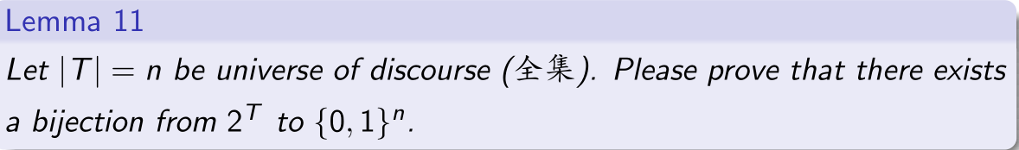
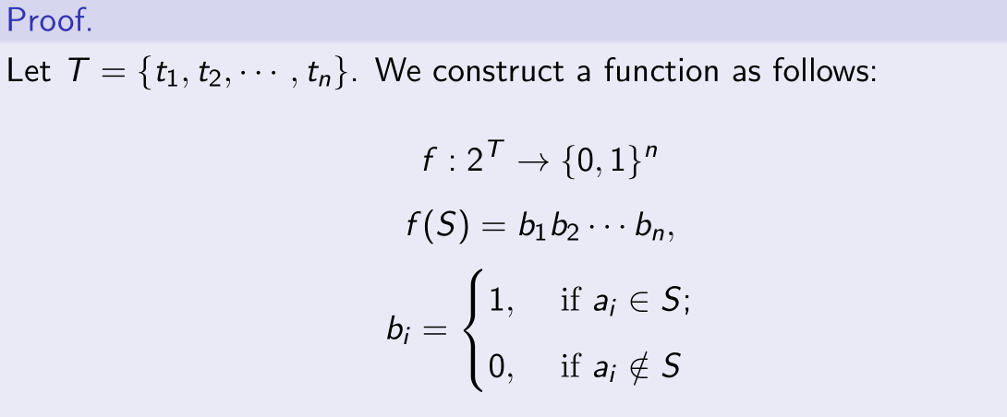
Bijection Proof Example

Slide 45


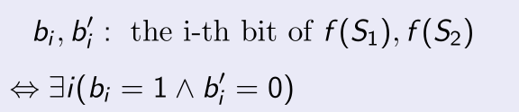
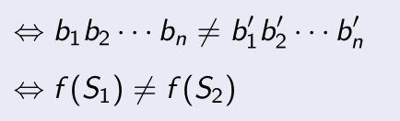
Bijection Proof Example

Slide 46

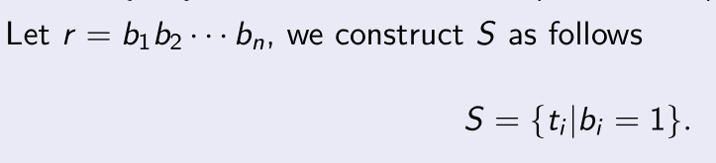

Bijection Proof Example

Slide 47
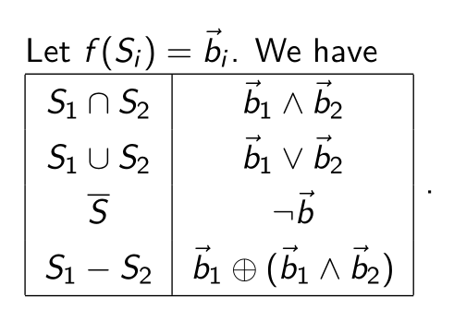
Bijection Proof Example

Slide 48
Bijections
For bijections f:A→B, there exists an inverse of f, written f ⁻¹: B→A
Intuitively, this is the function that undoes everything that f does
Formal definition : let f:A→B be a bijection. f ⁻¹ : B→A is its inverse, if

Slide 49
Bijections
Theorem: let f:A→B be a bijection and f ⁻¹ be its inverse, then

Slide 50
Bijections
Example 1: Let f: Z→Z be defined as f(x)=x+1. What is f⁻¹ ?
x+1=y
⇒ x=y-1
⇒ f⁻¹ (y)=y-1.

Slide 51
Bijections
Example 2: Let g: Z→N be defined as g(x)=|x|. What is g⁻¹ ?
g is not a bijection, g⁻¹ does not exist.

Slide 52
Operators over functions
Given any binary operator •:B×B→B, and functions f,g:A→B,
we define (f • g):A→B ∀a∈A, (f • g)(a) = f(a)•g(a).

Slide 53
Function Operator Example
+,× (plus,times) are binary operators over R. (Normal addition & multiplication.)
Therefore, we can also “add” and “multiply” functions f,g: R→R:
(f + g):R→R, where (f + g)(x) = f(x) + g(x)
(f × g):R→R, where (f × g)(x) = f(x) × g(x)

Slide 54
Graph and Some Case of Important Function

Slide 55
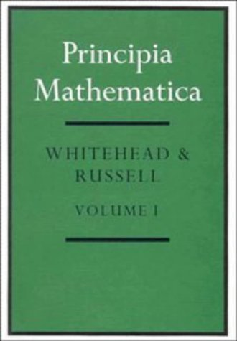
Aside About Representations
It is possible to represent any type of discrete structure (propositions, bit-strings, numbers, sets, ordered pairs, functions) in terms of some combination of other structures.
Perhaps none of these structures is more fundamental than the others. However, logic, and sets are often used as the foundation for all else. E.g. in ➔

Slide 56
A Couple of Key Functions
In discrete math, we frequently use the following two functions over real numbers:
The floor function向下取整 ⎣·⎦:R→Z, ⎣x⎦ :≡ max({i∈Z|i≤x}).
The ceiling function向上取整⎡·⎤ :
⎡x⎤ :≡ min({i∈Z|i≥x})

Slide 57
Visualizing Floor & Ceiling
Real numbers “fall to their floor” or “rise to their ceiling.”
3
⎡1.6⎤=2
2
.
.
1.6
1
.
⎣1.6⎦=1
0
⎡−1.4⎤= −1
−1
.
.
−1.4
−2
.
⎣−1.4⎦= −2
.
.
.
−3
−3
⎡−3⎤=⎣−3⎦= −3
Notes:
In other words, it matters whether you first apply minus then apply ceiling/floor, or the other way round
(i.e. first apply ceiling/floor then apply minus).

Slide 58
Do these equalities hold?
⎣−x⎦ = − ⎣x⎦ & ⎡−x⎤ = − ⎡x⎤

Slide 59
It depends on whether x is an integer
If x∈Z then ⎣x⎦ = ⎡x⎤ = x, so ⎣−x⎦ = −x = − ⎣x⎦ & ⎡−x⎤ = −x = − ⎡x⎤
But if x∉Z, then ⎣−x⎦ ≠ − ⎣x⎦ & ⎡−x⎤ ≠ − ⎡x⎤
E.g., ⎣−3.4⎦ = −4 ≠ −3 = − ⎣3.4⎦

Slide 60
Plots with floor/ceiling
Note that for f(x)=⎣x⎦, the graph of f includes the point (a, 0) for all values of a such that a≥0 and a<1, but not for the value a=1.
{x∈R : ⎣x⎦ = 0} = (informally) = {0,..,0.1,..0.2,..,…0.9,…} does not include its limit 1.
Sets that do not include all of their limit points are generally called open sets.
In a plot, we draw a limit point of a curve using an open dot (circle) if the limit point is not on the curve, and with a closed (solid) dot if it is on the curve.

Slide 61
Plots with floor/ceiling: Example
Plot of graph of function f(x) = ⎣x/3⎦:
f(x)
Set of points (x, f(x))
+2
−3
+3
x
−2

Slide 62
历史上的考题
Let f be a 1-1 correspondence function from A to B. Let S and T be subsets of B. Show that .
Poof:
Let . Then is a bijection. We need to prove

Slide 64
Since h is a a bijection, we know x=z. thus

Slide 65
P136
11
35 b) c)

Slide 66
End of the Section 2.3

